Slide 1

Retail Sales Analysis Project Report
End-to-End Data Analytics Case Study
Author: Bassam Mohammed
Notes:
1

Slide 2
Presentation Overview
1
Executive Summary
A high-level overview of the project's scope and key findings.
2
Dataset & Data Cleaning
Understanding the raw data and the preparation steps involved.
3
MySQL Analysis & Power BI Dashboards
Detailed insights from SQL queries and interactive visualizations.
4
Key Insights & Recommendations
Actionable strategies derived from the data analysis.
5
Tools & Skills Used
Technologies and methodologies employed in the project.
Notes:
2

Slide 3



Executive Summary
This project delivers a comprehensive retail analysis, spanning the entire data analytics pipeline from raw data to actionable insights. We focused on transforming complex datasets into clear, data-driven strategies for business growth.
Data Preparation
SQL Analysis
Visualization & Insights
Six raw datasets were meticulously cleaned and standardized using Python (Pandas), addressing issues like encoding problems, null values, and inconsistent naming conventions.
Ten critical business questions were addressed through optimized SQL queries in MySQL, extracting key metrics on sales, customer behavior, and employee performance.
Cleaned datasets were visualized in interactive Power BI dashboards, revealing trends in product sales, customer demographics, and promotional impact to inform strategic decisions.
Notes:
3

Slide 4
Dataset & Data Cleaning: Dataset Overview
The analysis was performed on six distinct retail datasets, encompassing a wide range of business operations from transactions to employee data.
Dataset
Records
Description
transactions.csv
~6.4M
Individual sales transactions, including product and discount details.
products.csv
~18K
Details for each product, such as category, subcategory, and production cost.
customers.csv
~1.6M
Customer demographics, including location, gender, and job.
stores.csv
35
Store locations and names across various regions.
employees.csv
404
Employee data, including their names and roles.
discounts.csv
181
Information on promotional events and discount percentages.
Notes:
4

Slide 5

Dataset & Data Cleaning: Data Cleaning (Python)
Data cleaning was a critical step, executed using the Pandas library in Python. This process ensured data integrity and consistency for subsequent analysis.
Removed null values and duplicate entries to enhance data reliability.
Standardized column names and formatting in Python
(Country name standardization was performed later in Power BI for reporting clarity)
Ensured proper character encoding by using utf8mb4 in MySQL for multilingual data support.
Outputted cleaned datasets as *_cleaned.csv files, ready for re-import into MySQL.
Notes:
5

Slide 6
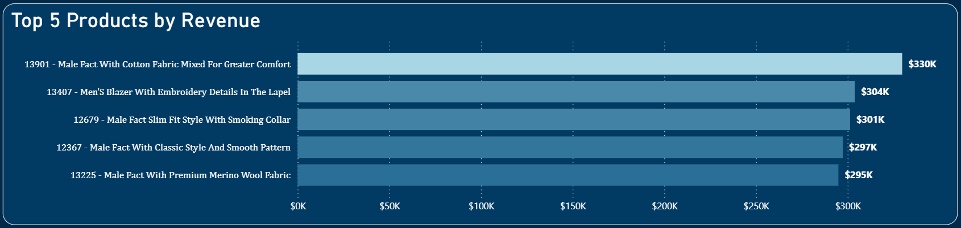
MySQL Analysis & Power BI Dashboards: Sales Performance
Our initial MySQL analysis focused on understanding core sales performance and product profitability.
Key Questions & Insights
Q1: Top Products by Revenue
Product 13901 generated the highest revenue at $330K, indicating strong market demand.
Notes:
6

Slide 7
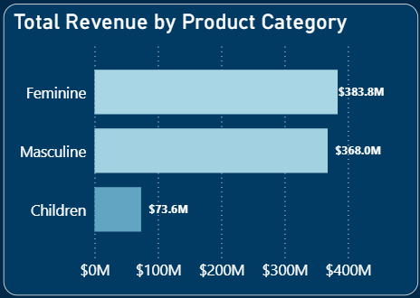
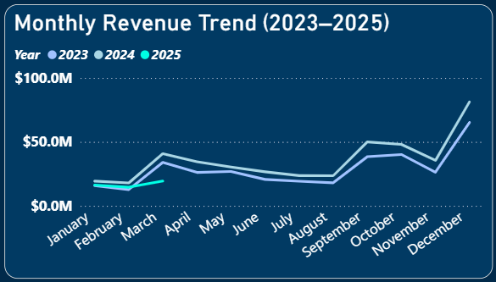
MySQL Analysis & Power BI Dashboards: Sales Performance
Our initial MySQL analysis focused on understanding core sales performance and product profitability.
Key Questions & Insights
Q2: Most Profitable Categories
Q3: Monthly Revenue Trends
The “Feminine" category dominated
revenue across all categories.
Sales consistently peaked in December each year, with elevated trends starting in September and October — indicating strong seasonal demand.
Notes:
6

Slide 8
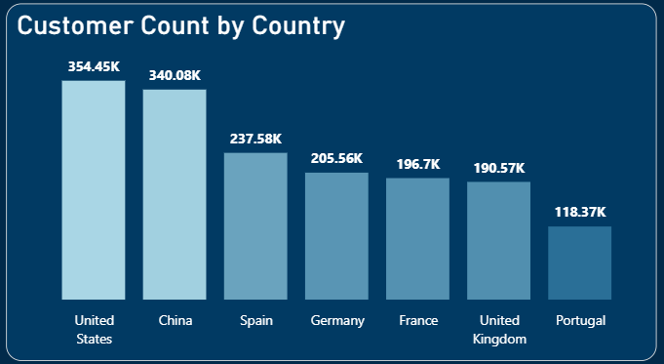
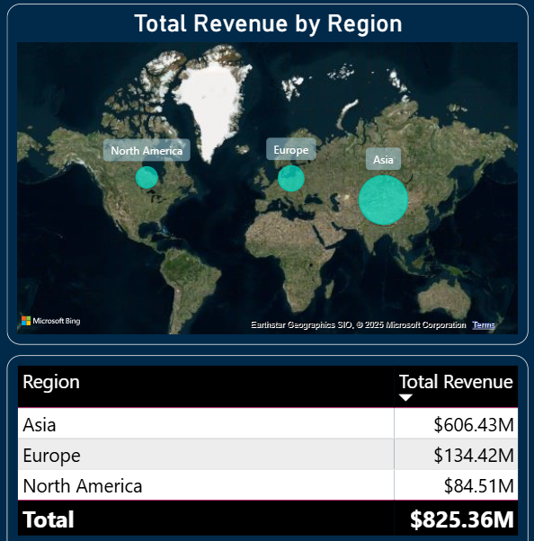
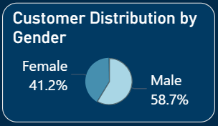
MySQL Analysis & Power BI Dashboards: Geography & Stores
This segment delved into geographical sales performance and customer demographics.
Key Questions & Insights
Q4: Top Regions by Revenue
Q5: Countries with Most Customers
Stores located in Asia and North America generated the most significant revenue, highlighting key markets.
The U.S. and China lead in customer count, each with over 340K customers, followed by key European markets like Spain and Germany.
Q6: Customer Distribution
Male customers outnumber females, suggesting they could be a key focus for targeted marketing strategies.
Notes:
6

Slide 9
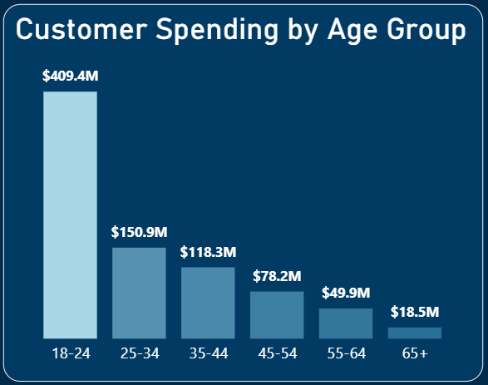
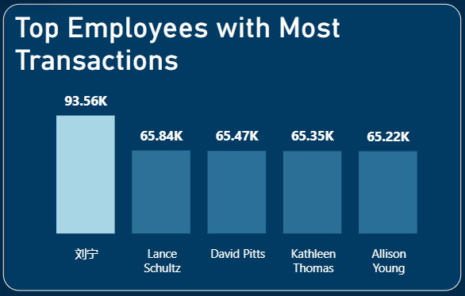
MySQL Analysis & Power BI Dashboards: Customer, Staff & Promotions
This analysis focused on customer engagement, employee performance, and the direct impact of discount strategies on sales volume.
Key Questions & Insights
Q7: Top Spending Age Groups
Q8: Most Active Employees
Young adults aged 18–24 drive the highest spending, making them ideal for targeted loyalty programs.
Employee 刘宁 recorded the highest number of transactions, indicating outstanding individual performance and operational efficiency.
Notes:
6

Slide 10
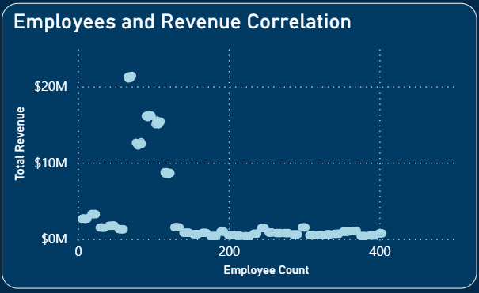
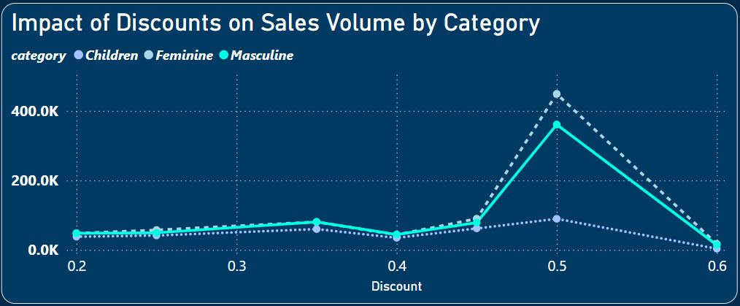
MySQL Analysis & Power BI Dashboards: Customer, Staff & Promotions
This analysis focused on customer engagement, employee performance, and the direct impact of discount strategies on sales volume.
Key Questions & Insights
Q9: Employees per Store vs. Revenue
Q10: Discount Impact on Sales Volume
The chart suggests that higher employee counts don't always translate to greater revenue — most top-revenue-generating stores have a moderate staff size, indicating a potential efficiency threshold.
A 50% discount consistently results in significant increases in sales volume in all of the three categories Children, Feminine, and Masculine.
Notes:
6

Slide 11
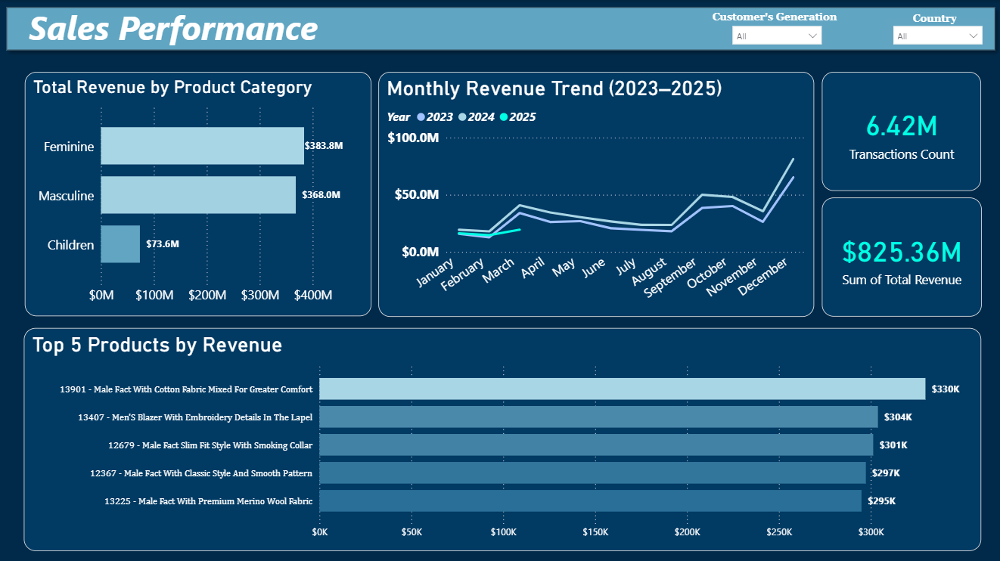
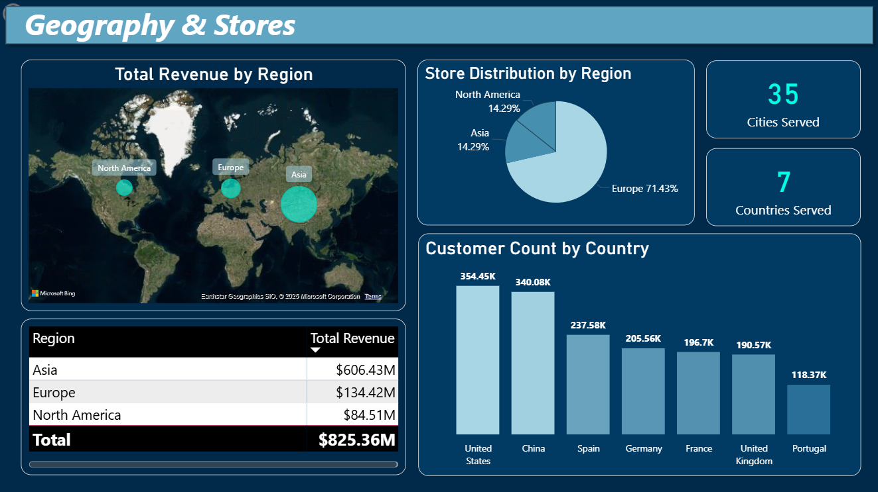
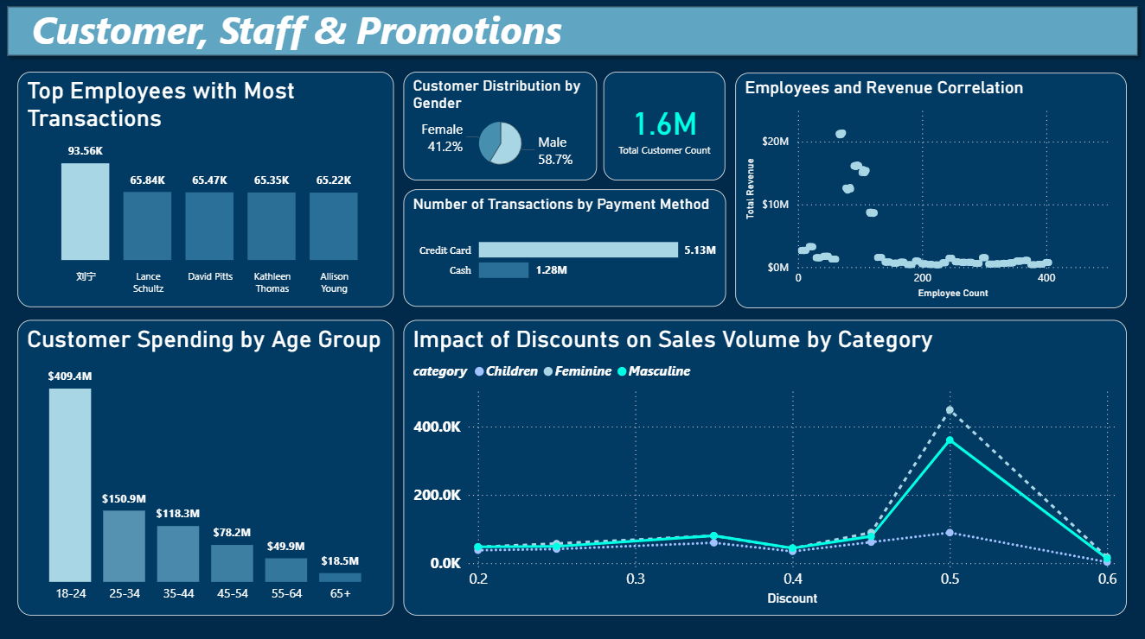
Power BI Dashboards Overview
Our Power BI dashboards deliver a clear, interactive snapshot of key retail metrics, making it easy for stakeholders to analyze performance and make informed decisions.
Page 1: Sales Performance
Page 2: Geography & Stores
Page 3: Customer, Staff & Promotions
Visualizes product performance and category sales trends with interactive cards and charts.
Offers insights into geographical sales distribution using maps and detailed demographic breakdowns.
Highlights customer spending behavior, staff performance, and the impact of promotions on sales.
Notes:
9

Slide 12





Key Insights & Recommendations
Based on our comprehensive analysis, we've identified several key insights and formulated actionable recommendations to optimize retail performance.
Promotional Focus
Product Investment
Talent Retention
50% discounts proved most effective in boosting sales across Feminine, Masculine, and Children categories. Future promotions should prioritize this range to maximize revenue.
Prioritize inventory and marketing on top-performing products like the "Male Fact With Cotton Fabric..." and "Men's Blazer...", which are driving the highest revenue.
Implement incentive programs to retain high-performing employees like "刘宁“ and “Lance Schultz”, who significantly contribute to transaction volumes.
Targeted Marketing
Strategic Expansion
Develop specific loyalty programs and marketing campaigns tailored to the 18–24 age group, identified as the highest-spending demographic.
Explore opportunities to expand store presence or optimize operations in high-performing regions like China and the USA to leverage existing market strengths.
Notes:
10

Slide 13




Tools & Skills Used
To achieve comprehensive data analysis and impactful visualizations, we leveraged a suite of powerful tools and honed essential skills.
Python
MySQL
Employed for robust data cleaning, extensive preprocessing, and feature engineering to prepare diverse datasets for analysis.
Utilized for efficient data storage, complex SQL queries, and managing relational databases to retrieve specific insights.
Power BI
PowerPoint
Implemented for designing interactive dashboards and dynamic reports, enabling intuitive data exploration and visualization.
Used for crafting compelling presentations and executive summaries, effectively communicating key findings and recommendations.
Key Skills Developed:
Advanced SQL for complex data retrieval and manipulation.
Proficient Data Cleaning techniques to ensure data accuracy and reliability.
Effective use of Joins to integrate disparate data sources.
Strategic Data Visualization for clear and concise reporting.
Applied Business Intelligence principles to drive actionable insights.
Notes:
2

Slide 14

Thank You
Github: https://github.com/Doodad7
LinkedIn: https://www.linkedin.com/in/bassam-mohammed-ba3284315/
Notes:
1

